Slide 1
Intro to Cloud Computing CS4037 (BCS-6A) Lecture 03
Instructor: Danyal Farhat
Lecturer, Department of Computer Science, FAST
07 February, 2023

Slide 2
Module 1: Cloud Concepts Overview
AWS Academy Cloud Foundations
© 2019 Amazon Web Services, Inc. or its Affiliates. All rights reserved.

Slide 3
Section 3: Introduction to Amazon Web Services (AWS)
Module 1: Cloud Concepts Overview

Slide 4



What are web services?
A web service is any piece of software that makes itself available over the internet and uses a standardized format—such as Extensible Markup Language (XML) or JavaScript Object Notation (JSON)—for the request (input dataset) and the response (output dataset) of an application programming interface (API) interaction.
It is not tied to any one operating system or programming language.
It is self-describing via an interface definition file and it is discoverable.
Request message
Internet
Response message
Client
Web service

Slide 5
What is AWS?
AWS is a secure cloud platform that offers a broad set (an ecosystem) of global cloud-based products.
AWS provides you with on-demand access to compute, storage, network, database, and other IT resources and management tools.
You can immediately provision and launch AWS resources.
The resources are ready for you to use in minutes.

Slide 6
What is AWS?
AWS offers flexibility. AWS environment can be:
Reconfigured and updated on demand
Scaled up or down manually or automatically to meet usage patterns and optimize spending
Shut down temporarily or permanently
The billing for AWS services becomes an operational expense instead of a capital expense.
You pay only for the individual services you need, for as long as you use them.

Slide 7
What is AWS?
AWS services are designed to work together to support virtually any type of application or workload.
Think of these services like building blocks, which you can assemble quickly to build sophisticated, scalable solutions, and then adjust them as your needs change.

Slide 8








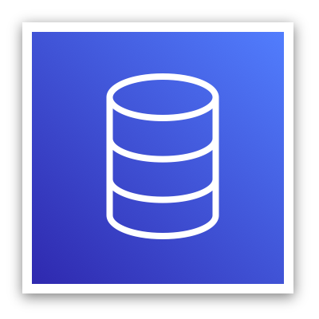














Categories of AWS services
Analytics
Application
Integration
AR and VR
Blockchain
Business Applications
Compute
Cost Management
Customer Engagement
Database
Developer Tools
End User
Computing
Game Tech
Internet of Things
Machine Learning
Management and Governance
Media Services
Migration and
Transfer
Mobile
Networking and
Content Delivery
Robotics
Satellite
Security, Identity, and
Compliance
Storage
Notes:
AWS services fall under different categories, and each category contains one or more services. You can select the services that you want from these different categories to build your solutions.

Slide 9


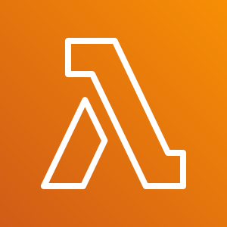







Choosing a service
The service you select depends on your business goals and technology requirements.
Amazon EC2
VMware Cloud on AWS
AWS Lambda
?
Amazon ECS
AWS Elastic Beanstalk
Amazon EKS
AWS Fargate
Amazon Lightsail
AWS Outposts
AWS Batch

Slide 10
Choosing a service (Cont.)
Amazon EC2: You want complete control over your AWS computing resources.
AWS Lambda: You want to run your code and not manage or provision servers.
AWS Elastic Beanstalk: You want a service that deploys, manages, and scales your web applications for you.
Amazon Lightsail: You need a lightweight cloud platform for a simple web application.

Slide 11
Choosing a service (Cont.)
AWS Batch: You need to run hundreds of thousands of batch workloads.
AWS Outposts: You want to run AWS infrastructure in your on-premises data center.
Amazon Elastic Container Service (Amazon ECS), Amazon Elastic Kubernetes Service (Amazon EKS), or AWS Fargate: You want to implement a containers or micro-services architecture.
VMware Cloud on AWS: You have an on-premises server virtualization platform that you want to migrate to AWS.
Notes:
Similarly, there are a variety of services for you to choose from in the other categories, and the number of offerings keeps growing.

Slide 12
Services covered in this course
Compute services –
Amazon EC2
AWS Lambda
AWS Elastic Beanstalk
Amazon EC2 Auto Scaling
Amazon ECS
Amazon EKS
Amazon ECR
AWS Fargate
Storage services –
Amazon S3
Amazon S3 Glacier
Amazon EFS
Amazon EBS
Management and Governance services –
AWS Trusted Advisor
AWS CloudWatch
AWS CloudTrail
AWS Well-Architected Tool
AWS Auto Scaling
AWS Command Line Interface
AWS Config
AWS Management Console
AWS Organizations
Database services –
Amazon RDS
Amazon DynamoDB
Amazon Redshift
Amazon Aurora
Security, Identity, and Compliance services –
AWS IAM
Amazon Cognito
AWS Shield
AWS Artifact
AWS KMS
Networking and Content Delivery services –
Amazon VPC
Amazon Route 53
Amazon CloudFront
Elastic Load Balancing
AWS Cost Management services –
AWS Cost & Usage Report
AWS Budgets
AWS Cost Explorer

Slide 13

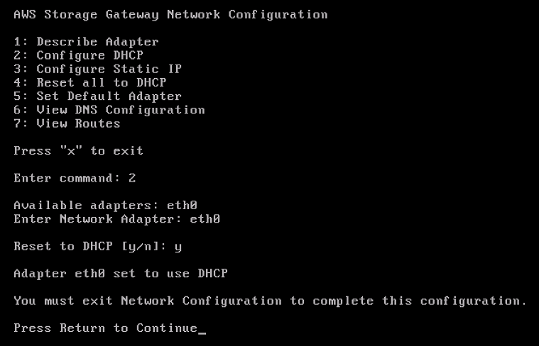
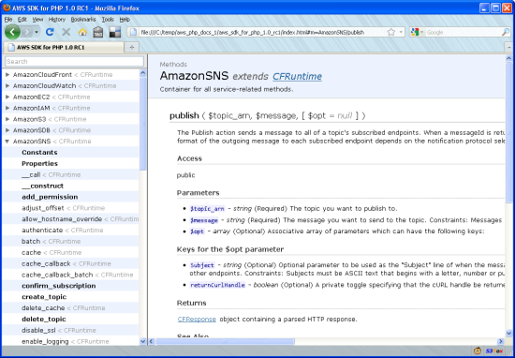
Three ways to interact with AWS
AWS Management Console
Easy-to-use graphical interface
Command Line Interface (AWS CLI)
Access to services by discrete commands or scripts
Software Development Kits (SDKs)
Access services directly from your code (such as Java, Python, and others).
AWS provides packages that enable accessing AWS in a variety of popular programming languages.
Notes:
All three options are built on a common REST-like API that serves as the foundation of AWS.
To learn more about tools you can use to develop and manage applications on AWS, see Tools to Build on AWS.

Slide 14

Section 3 key takeaways
AWS is a secure cloud platform that offers a broad set of global cloud-based products called services that are designed to work together.
There are many categories of AWS services, and each category has many services to choose from.
Choose a service based on your business goals and technology requirements.
There are three ways to interact with AWS services.

Slide 15
Section 4: Moving to the AWS Cloud – The AWS Cloud Adoption Framework (AWS CAF)
Module 1: Cloud Concepts Overview

Slide 16
Why AWS CAF?
Cloud computing offers many advantages over the traditional model.
For most organizations, cloud adoption does not happen instantly.
Technology is one thing, but an organization also consists of people and processes, and these three elements must all be in alignment for successful cloud adoption.

Slide 17
Why AWS CAF?
Cloud adoption requires that stakeholders across all organizational units—both within and outside IT—support fundamental IT changes.
AWS CAF was created to help organizations design and travel an accelerated path to successful cloud adoption.
Cloud computing introduces a significant shift in how technology is obtained, used, and managed.
It also shifts how organizations budget and pay for technology services.

Slide 18
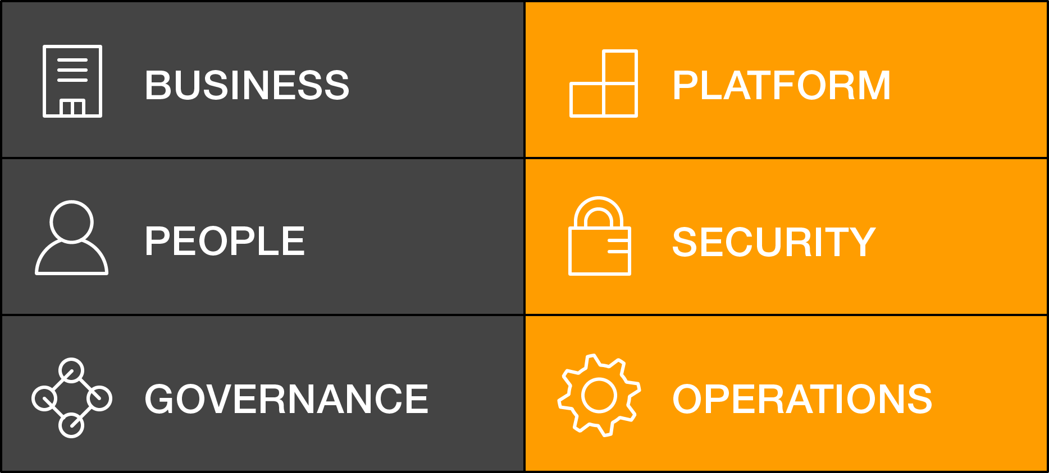
AWS Cloud Adoption Framework (AWS CAF)
AWS CAF provides guidance and best practices to help organizations build a comprehensive approach towards successful cloud adoption.
AWS CAF is organized into six perspectives.
Perspectives consist of sets of capabilities.
AWS CAF perspectives

Slide 19
Six core perspectives
Focus on business capabilities
Focus on technical capabilities

Slide 20
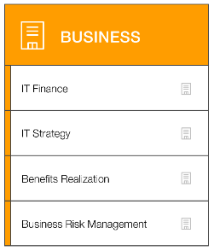

Business perspective
We must ensure that IT is aligned with business needs, and that IT investments can be traced to demonstrable business results.
IT finance
IT strategy
Benefits realization
Business risk management
Business managers, finance managers, budget owners, and strategy stakeholders
Business perspective capabilities
Notes:
Stakeholders from the Business perspective (for example, business managers, finance managers, budget owners, and strategy stakeholders) can use the AWS CAF to create a strong business case for cloud adoption and prioritize cloud adoption initiatives. Stakeholders should ensure that an organization’s business strategies and goals align with its IT strategies and goals.

Slide 21
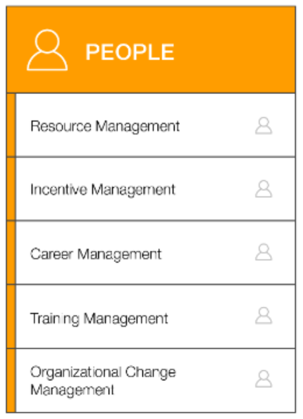
People perspective
We must prioritize training, staffing, and organizational changes to build an agile organization.
Resource management
Incentive management
Career management
Training management
Organizational change management
Human resources, staffing, and people managers
People perspective capabilities
Notes:
Stakeholders from the People perspective (for example, human resources, staffing, and people managers) can use the AWS CAF to evaluate organizational structures and roles, new skill and process requirements, and identify gaps. Performing an analysis of needs and gaps can help prioritize training, staffing, and organizational changes to build an agile organization.

Slide 22
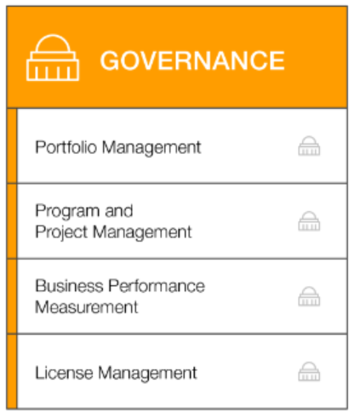
Governance perspective
We must ensure that skills and processes align IT strategy and goals with business strategy and goals so the organization can maximize the business value of its IT investment and minimize business risks.
Portfolio management
Program and project management
Business performance measurement
License management
Governance perspective capabilities
CIO, program managers, enterprise architects, business analysts, and portfolio managers
Notes:
Stakeholders from the Governance perspective (for example, the Chief Information Officer or CIO, program managers, enterprise architects, business analysts, and portfolio managers) can use the AWS CAF to focus on the skills and processes that are needed to align IT strategy and goals with business strategy and goals. This focus helps the organization maximize the business value of its IT investment and minimize the business risks.

Slide 23
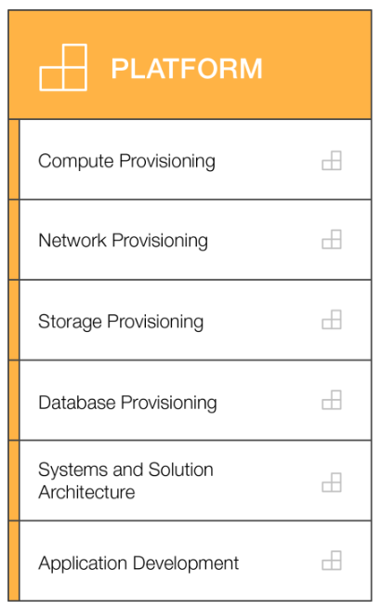
Platform perspective
We must understand and communicate the nature of IT systems and their relationships. We must be able to describe the architecture of the target state environment in detail.
Compute provisioning
Network provisioning
Storage provisioning
Database provisioning
Systems and solution architecture
CTO, IT managers, and solutions architects
Application development
Platform perspective capabilities
Notes:
Stakeholders from the Platform perspective (for example, Chief Technology Officer or CTO, IT managers, and solutions architects) use a variety of architectural dimensions and models to understand and communicate the nature of IT systems and their relationships. They must be able to describe the architecture of the target state environment in detail. The AWS CAF includes principles and patterns for implementing new solutions on the cloud, and for migrating on-premises workloads to the cloud.

Slide 24
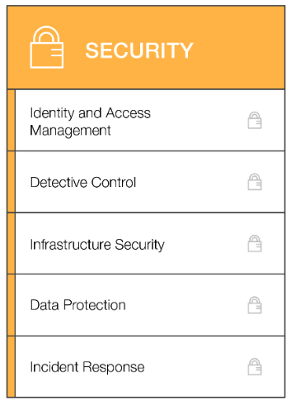
Security perspective
We must ensure that the organization meets its security objectives for visibility, auditability, control, and agility.
Identity and access management
Detective control
Infrastructure security
Data protection
CISO, IT security managers, and IT security analysts
Incident response
Security perspective capabilities
Notes:
Stakeholders from the Security perspective (for example, Chief Information Security Officer or CISO, IT security managers, and IT security analysts) must ensure that the organization meets security objectives for visibility, auditability, control, and agility. Security perspective stakeholders can use the AWS CAF to structure the selection and implementation of security controls that meet the organization’s needs.

Slide 25
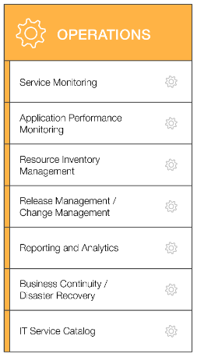
Operations perspective
We align with and support the operations of the business, and define how day-to-day, quarter-to-quarter, and year-to-year business will be conducted.
Service monitoring
Application performance monitoring
Resource inventory management
Release management/ change management
Reporting and analytics
Business continuity/ Disaster recovery
IT operations managers and IT support managers
IT service catalog
Operations perspective capabilities
Notes:
Stakeholders from the Operations perspective (for example, IT operations managers and IT support managers) define how day-to-day, quarter-to-quarter, and year-to-year business is conducted. Stakeholders from the Operations perspective align with and support the operations of the business. The AWS CAF helps these stakeholders define current operating procedures. It also helps them identify the process changes and training that are needed to implement successful cloud adoption.

Slide 26
Section 4 key takeaways
Cloud adoption is not instantaneous for most organizations and requires a thoughtful, deliberate strategy and alignment across the whole organization.
The AWS CAF was created to help organizations develop efficient and effective plans for their cloud adoption journey.
The AWS CAF organizes guidance into six areas of focus, called perspectives.
Perspectives consist of sets of business or technology capabilities that are the responsibility of key stakeholders.

Slide 27
Module wrap-up
Module 1: Cloud Concepts Overview

Slide 28
Module summary
In summary, in this module you learned how to:
Define different types of cloud computing models
Describe six advantages of cloud computing
Recognize the main AWS service categories and core services
Review the AWS Cloud Adoption Framework

Slide 29
Additional resources
What is AWS? YouTube video:
https://www.youtube.com/watch?v=a9__D53WsUs
Cloud computing with AWS website: https://aws.amazon.com/what-is-aws/
Overview of Amazon Web Services whitepaper: https://d1.awsstatic.com/whitepapers/aws-overview.pdf
An Overview of the AWS Cloud Adoption Framework whitepaper: https://d1.awsstatic.com/whitepapers/aws_cloud_adoption_framework.pdf
6 Strategies for Migrating Applications to the Cloud AWS Cloud Enterprise Strategy blog post: https://aws.amazon.com/blogs/enterprise-strategy/6-strategies-for-migrating-applications-to-the-cloud/

Slide 30
Thank You
Notes:
Thanks for participating!

